Slide 1
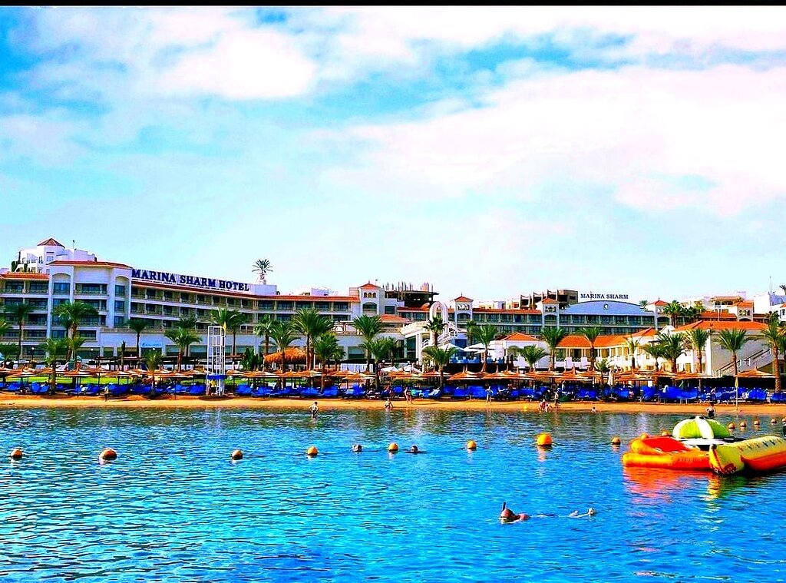

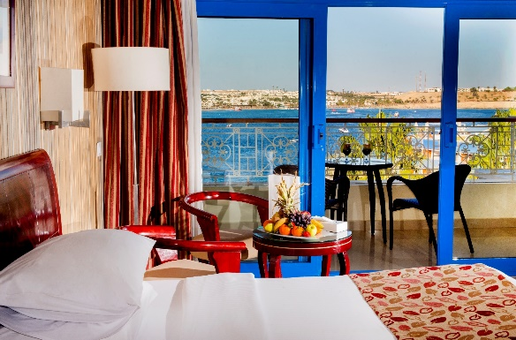
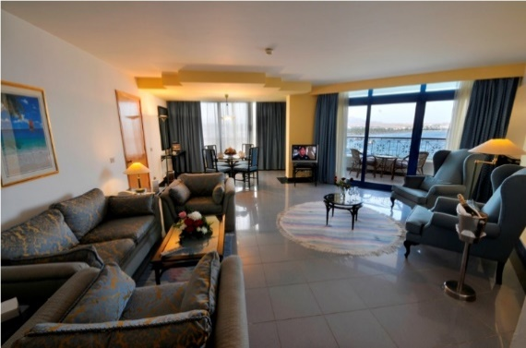
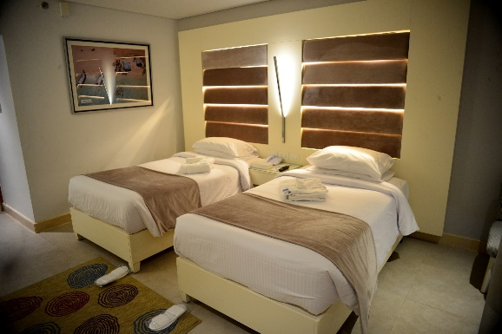




HOTEL
FACT SHEET
ABOUT
Marina Sharm Hotel has 293 units, which are separated into 57 Standard Garden View, 52 Standard Sea View, 59 Superior Sea View, 81 Deluxe Sea View, 28 Royal Sea & Pool View Rooms, 01 Presidential Suite & 04 Junior Sea View Suites. All rooms and suites are sea view, having TV & Satellite channels, direct Telephone line, and mini Bar, Safety Box, Hairdryer, air-conditioned and 24 hours room service.
Marina Sharm El Sheikh is located in the center of Sharm El Sheik city on Sinai Peninsula Overlooking Naama Bay, with the blue crystal water of the red sea. The hotel is the ideal place for holiday makers from all over the world, either relaxing or for programs including diving to explore the magnificent coral reefs. The management of the hotel has studied every mean to create the utmost comfort, pleasure and relaxation to satisfy their guests, and is hoping to fulfill all the needs and bring a dream holiday to life.
LOCATION
Marina Sharm is located direct on the sea in the heart of Naama Bay at a distance of 11 Km from the Sharm El Sheikh International airport, 5 km from the bus station and 7 km from the Old Market. The hotel is on the far edge of the bay,
where the whole bay is seen from all rooms with a view of a life time.
GREEN STAR HOTEL
Welcome in one of Egypt's most environmentally friendly hotels - a “Green Star Hotel”
As “Green Star Hotel” we are committed to the reduction of our carbon footprint and the protection of our environment. We strive to preserve the flora and fauna of our landscape and the unique marine life and biodiversity of Egypt. By implementing numerous environmental activities in the areas of conserving energy and water, reducing waste generation and recycling, we are committed to environmental protection in every section of our hotel.

Slide 2
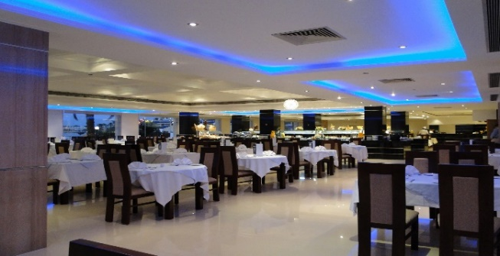
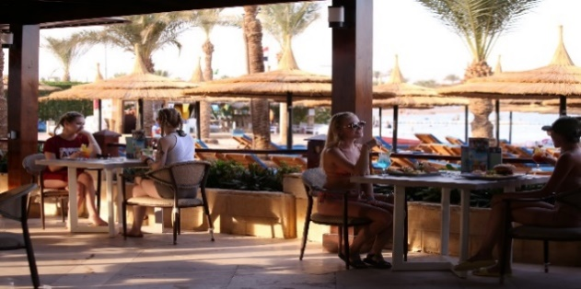

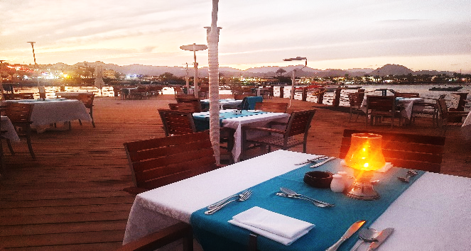
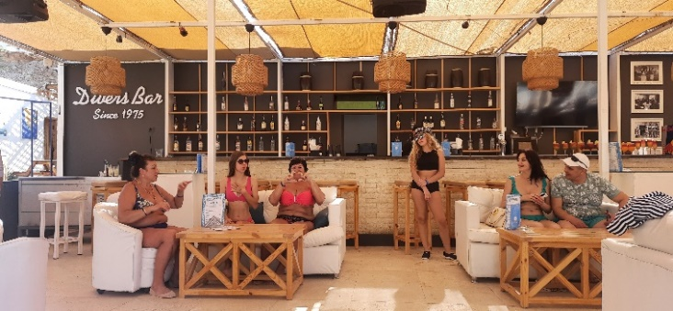
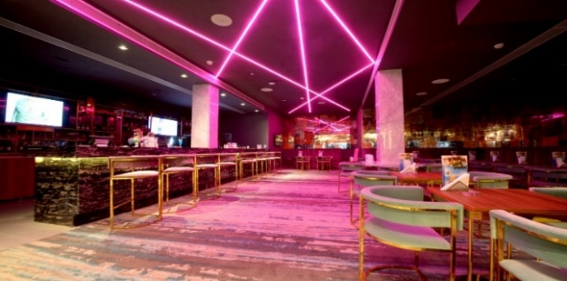
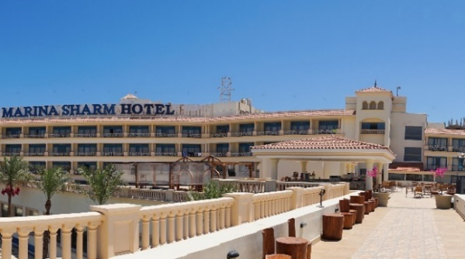
Dining
Marina Restaurant
The main dining room, where the
guest would enjoy international breakfast and Dinner buffets plus a la carte menu the whole day while watching the beautiful bay. We can host over 280 guests.
Bay Watch Restaurant
Located at the beach area, where you can feel the real relaxing atmosphere,
the restaurant able to host 80 Guests.
The Grill Restaurant
Located at the beach area and pool area, where you can enjoy excellent taste of oriental food.
The Greek Restaurant
Located at the Jetty area, where you can have a taste of Greece in the middle of the Red Sea charming magic.
Bars
Lounge Bar
Enjoys a classical atmosphere while drinking your preferred cocktails.
Garden Bar:
Enjoys an open-air atmosphere while drinking your preferred cocktails and enjoying entertainment shows.
Palm Bar
By the pool area serving the All Inclusive
bar, which satisfies the all-inclusive guests through- out the day.
Sky – Lounge Terrace Bar
At the hotel third floor where you can have the best view in Sharm El Sheikh, for the whole bay in a great atmosphere enjoying your favorite drinks and variety of Snacks.
Divers Bar
Is the perfect place where you can enjoy food and beverages with the sea view and enjoying our Karaoke Nights over sea shores.

Slide 3
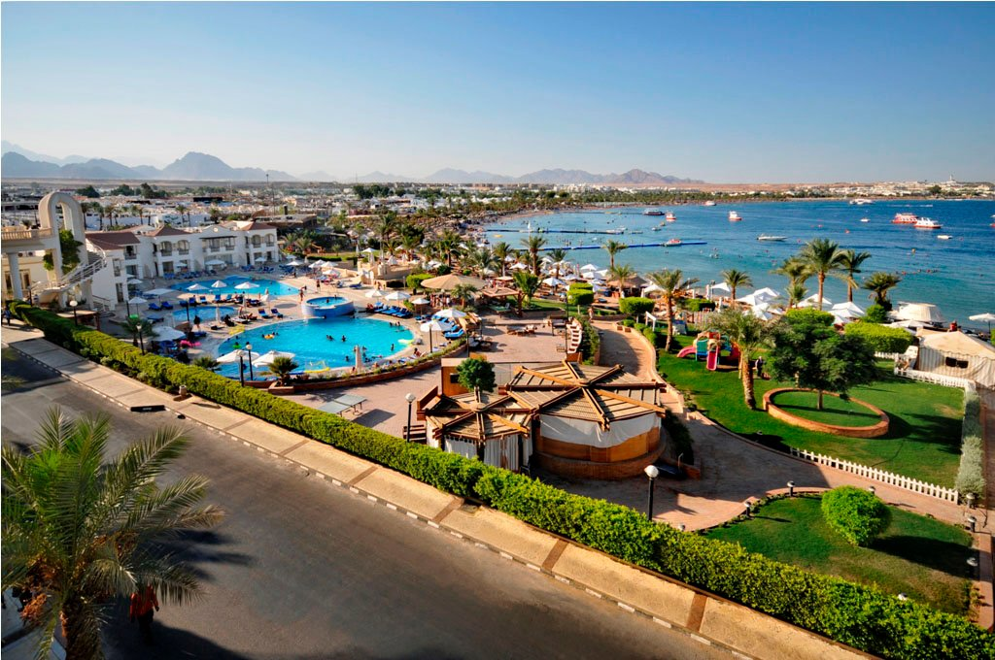
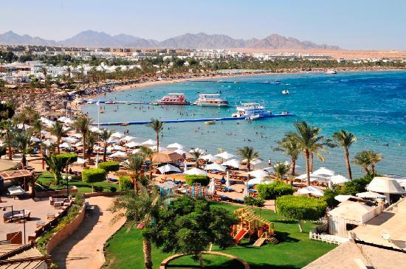

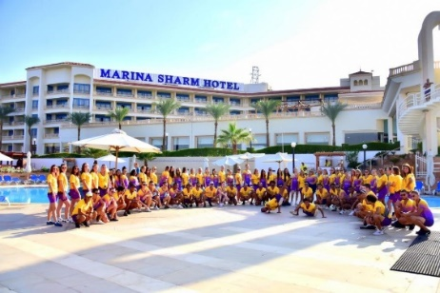
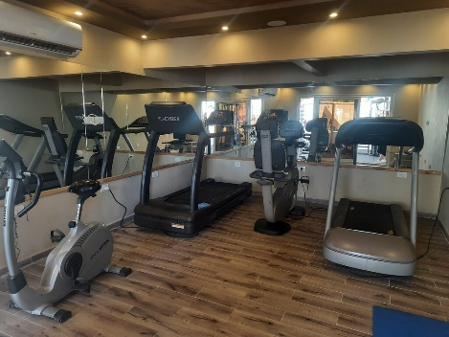
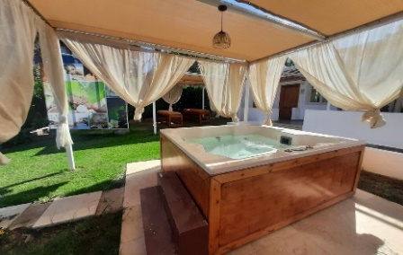
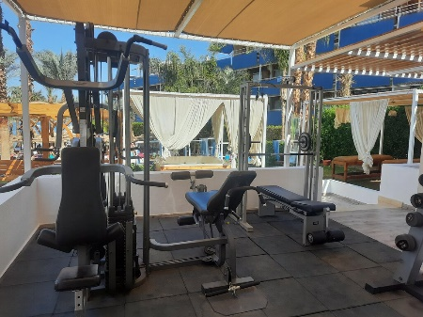
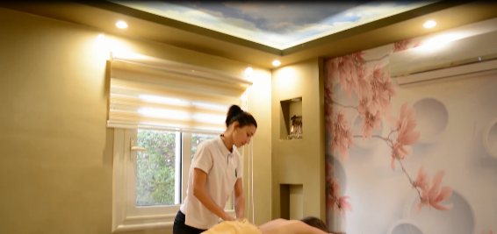
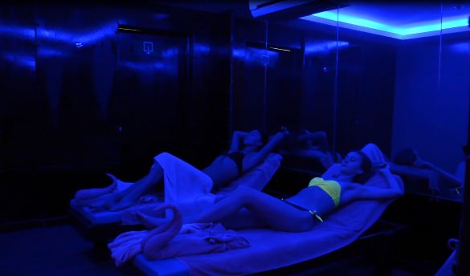
Recreation Facilities
You are welcome to enjoy your leisure time by experiencing any of the hotel facilities
- 03 swimming pools, 2 (one heated) for adults
and 1 for children.
- A beautiful 250m Sandy beach with excursion activities and animation activities.
- Diving center that would show you the
secrets of the Red Sea.
- A beach volley playground.
- Billiard, Darts, Animation games.
- GYM, Jacuzzi & Massage.
- Wireless Internet available.
- Water Sports center.
- Bazar in the lobby area.
- Spa.
- Pharmacy.

Slide 4
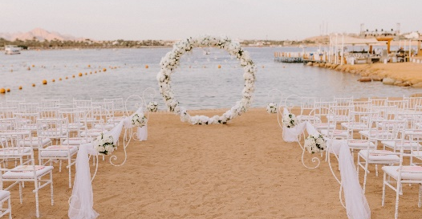
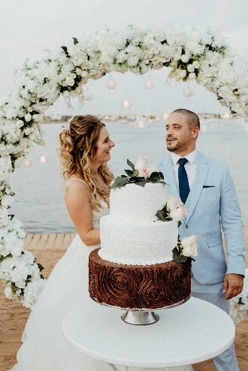
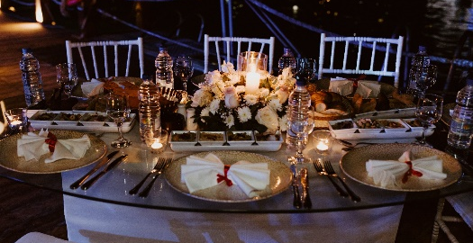
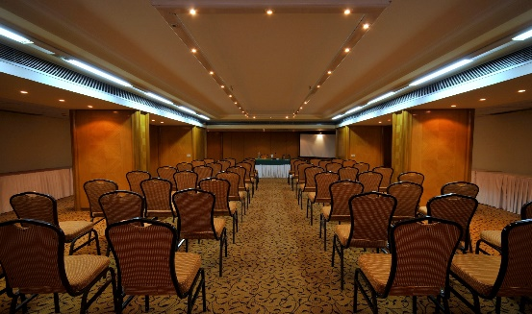
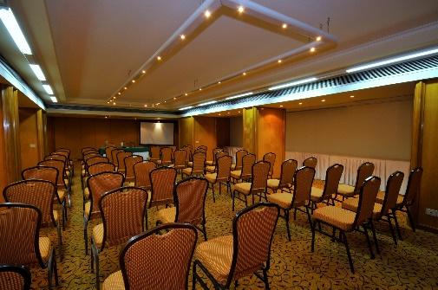
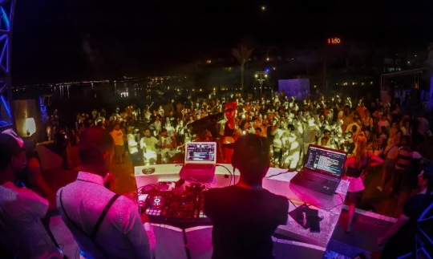
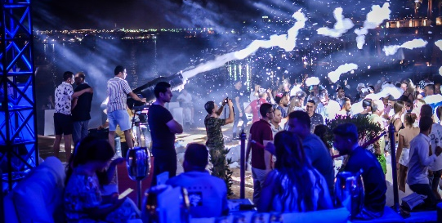

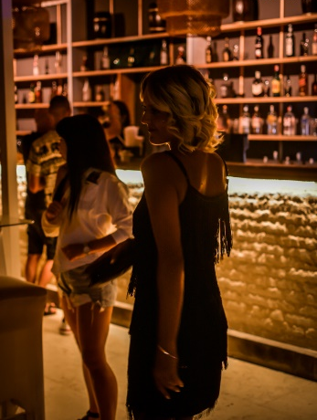



Meetings & Events Facilities
The hotel has a multipurpose meeting and conference room that can accommodate up to 120 Persons according to the set up. The audio visual equipment’s available will fulfill with all your Function’s needs.
We have various outlets for hosting and planning different events like:
Beach Weddings
Night Parties
Romantic Dinners
Foam parties
Entertainment shows
Kids Parties
Birthdays
Others
Naama Bay-Sharm El Sheikh - Egypt
Tel.(20) 69-360170 • Fax (20) 69-360171 • E-mail: res@marinasharm.com

